Slide 1
Modern CPU Architecture and Concurrency
Why this course matters

Slide 2
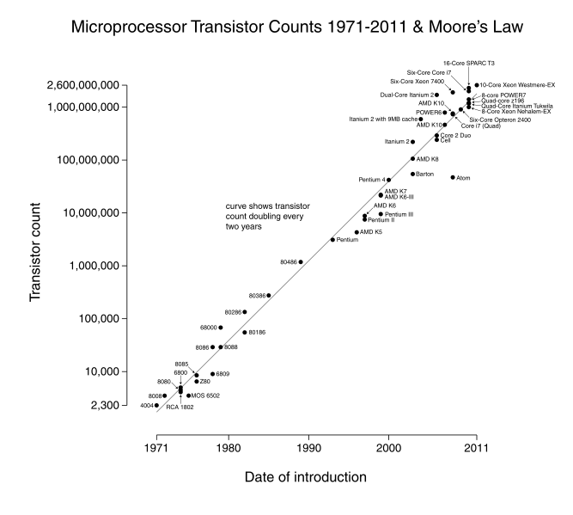

Slide 3
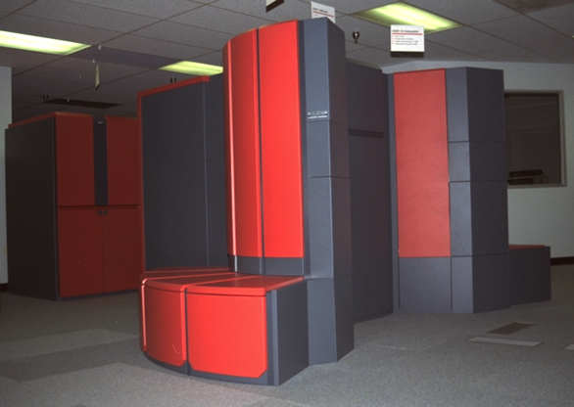
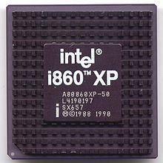
Looming Challenge Thirty Years Ago
Technology driver transition
LSI to VLSI
Emergence of MOS, RISC microprocessors
Availability of dense semiconductor DRAM
Local area and system area networks
Paradigm Shift required
Exploit “killer micro”
Increase performance, reduce cost
Transition away from vector, PVP, and SIMD-array
How to structure and program new class of systems
Everything was about to change
How do we program future class of systems
Do we keep a shared memory model
New programming methods; what about legacy codes
Used courtesy of Bob Lucas
Summary | X

Slide 4
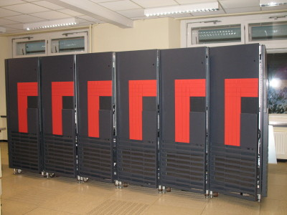
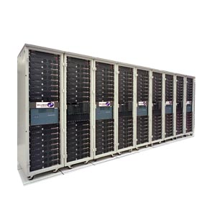
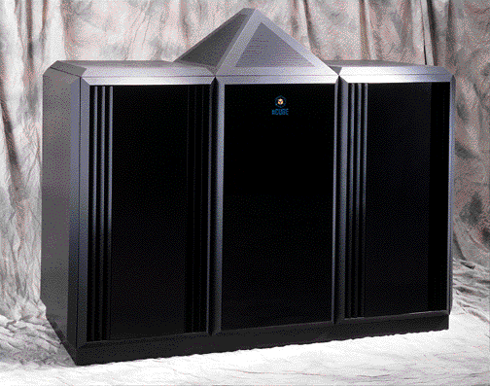
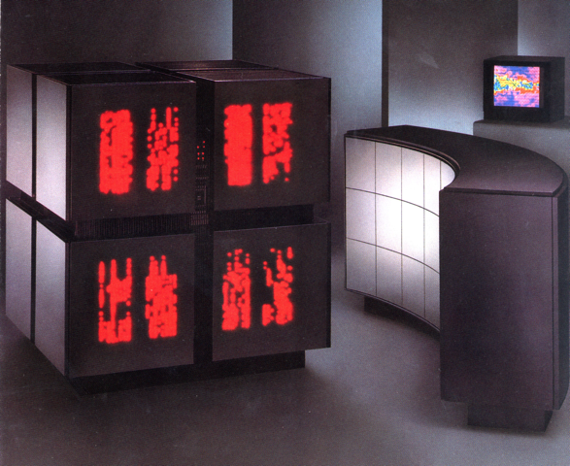
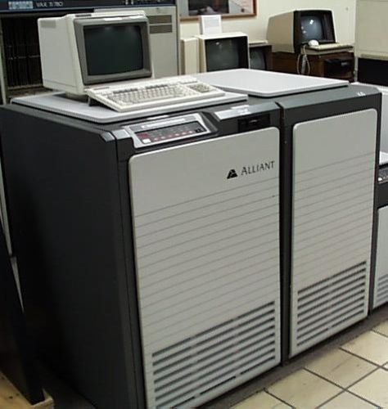
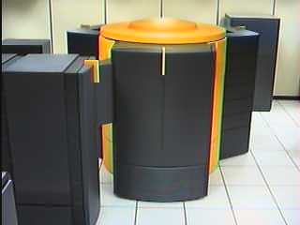
The Future was Uncertain
BBN TC-2000 NUMA
Denelcor HEP multithreaded
Intel Touchstone Delta
TMC CM-2
Alliant FX/8
KSR-1
Cray T3D/E
J-Machine
Ncube
Cray C90
UIUC/CSRD Cedar
Used courtesy of Bob Lucas
Summary | X

Slide 5
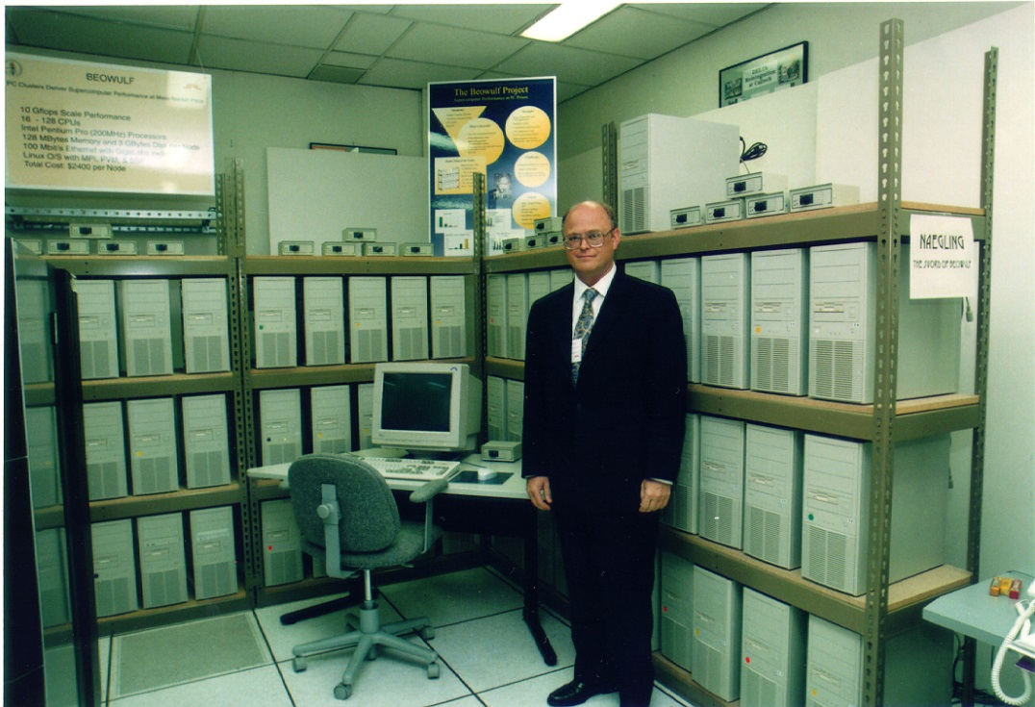
HPC Finally Reached a Stable Point
COTS Components
Leverage mainstream commercial processors
Cache-based hierarchical memories
Distributed Memory Architecture
Familiar software on processors (Fortran, C, and C++)
Message Passing Interface (MPI)
Evolving for two decades
Beowulf is the epitome
All off-the-self
PC components
Ethernet networks
Linux
gcc
Used courtesy of Bob Lucas
Summary | X

Slide 6
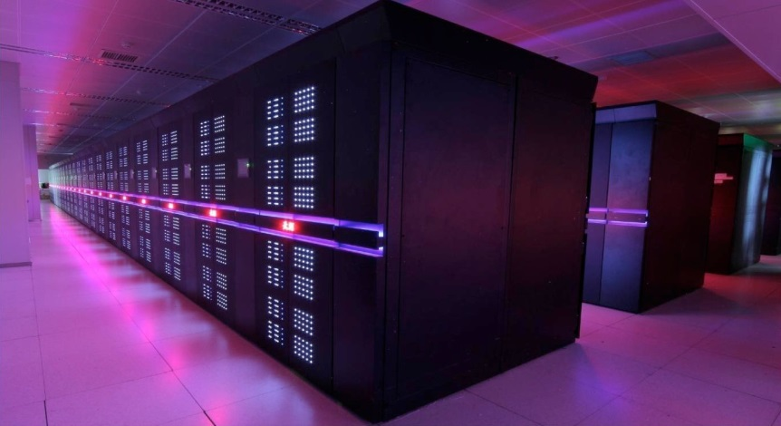
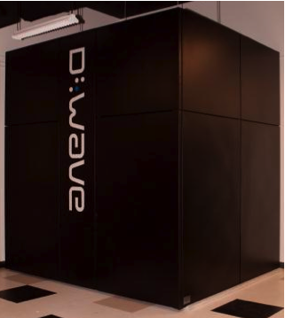
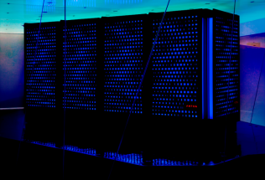
Need More Capability?
Massive Scaling
Tianhe-2 (3M cores)
Exploit a New Phenomenon
D-Wave Quantum Annealer
Application Specific Systems
D.E. Shaw Research Anton
Used courtesy of Bob Lucas
Introduction | 2

Slide 7
Our mental model
Von Neumann architecture
CPU
Control
Input
ALU
Output
Memory
Used courtesy of Bob Lucas

Slide 8
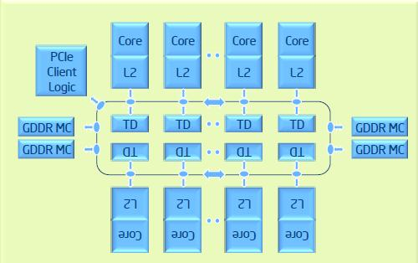
Reality
Intel Xeon Phi architecture

Slide 9
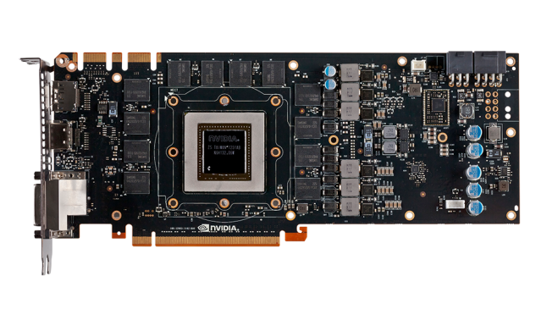
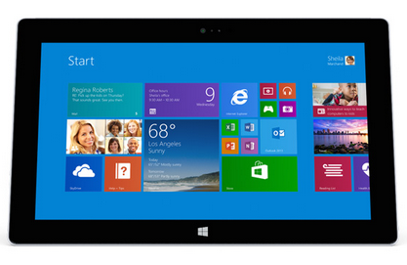

How do we program these?

Slide 10
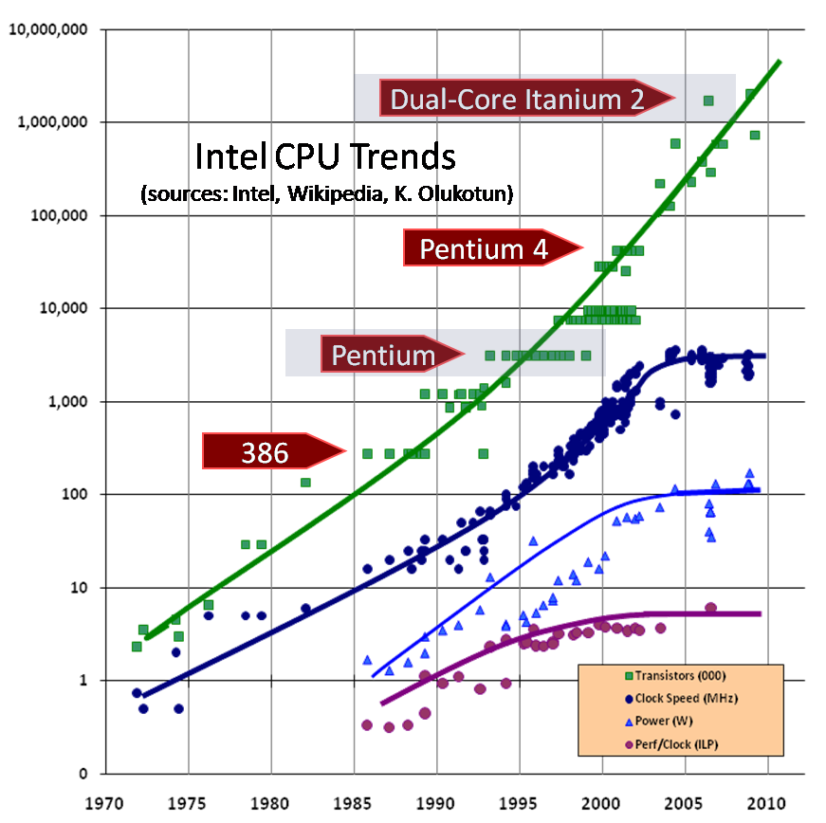
Free Lunch is over (2005)

Slide 11
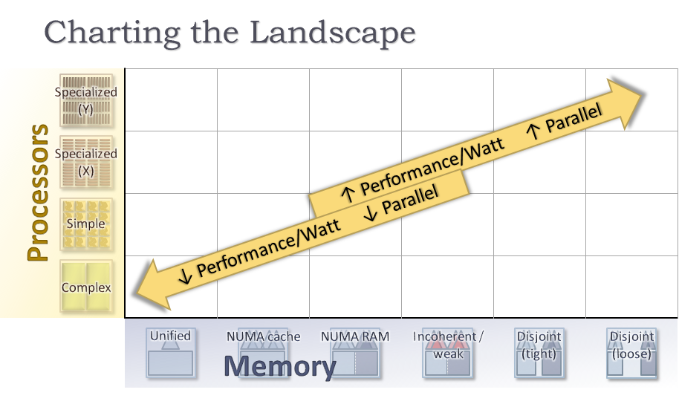
The hardware Jungle (2012)

Slide 12
Fundamental principles, new tools
Principles
Encapsulation
Single responsibility
Separation of interface from implementation
Tools
Threads
Atomics
Locks
Tasks
MPI

Slide 13
New performance metrics
Performance per watt
Less reliable results
Expected failures
Exploitation of embarrassingly parallel algorithms
Amdahl's Law
Memory allocation, location of data
Segregation of serial and parallel sections of code
Dot product
Custom hardware – quantum computers?

Slide 14
Language evolution
Early years – Focus on hardware
Fortran, C, C++
2000’s – Optimize for developer productivity
Managed languages
Java
C#
Dynamic Languages
Python
Ruby
Present – Optimize for parallel architectures
Fortran, C, C++
Functional languages (data is not shared by default)
Haskell
Erlang
Clojure

Slide 15
What does this mean for us?
The cusp of a paradigm shift in software development
What you need to learn
All of the time-tested software development skills
New concurrent development tools
Underlying hardware
A new mental model
What you need to remember
Computers do what we tell them (no behavior is random)
Maintain conceptual integrity
Verify, verify, verify

Slide 16
Course Outline
Day 1 - Introduction and basics
Modern CPU architecture and concurrency
Introduction to Git
Test Driven Design
Dennard Scaling
Day 2 - Basic tools for concurrency
Threads
Mutexes
Asynchronous operations

Slide 17
Course Outline (2)
Day 3 - More tools and techniques
Atomics and the C++ memory model
Designing concurrent software
Task-based concurrency
Day 4 – Case Studies
Case study: Atomics and object lifetime
Case study: Making a cache thread safe
Case study: Synchronizing a thread pool
Day 5 - Distributed memory parallel concurrency
Introduction to MPI
Hybrid concurrency

